Slide 1

Medium Exposure Risk Level Training
COVID-19 Emergency Temporary Standard, 16VAC25-220

Slide 2
Exposure Risk Levels
Prevent the spread of the virus
Applies to every place of employment
within the jurisdiction of the VOSH program
Based on exposure risk levels based
on hazards present or job tasks
and defined as:
Very High, High, Medium,
and Lower.

Slide 3
DATES
Training Dates -Very high, High, and Medium
General training within 30 days – August 26
Lower –exempt but must provide employees with basic written or oral info on hazards and measures to minimize exposure
Infectious Disease Preparedness and Response Plan Dates
Very high, High, Medium –need plan and train within 60 days – September 26

Slide 4
Protect Your Employees
Social Distancing
Self monitoring
Post signs
Offer disposable face masks
PPE
Clean and Disinfect Training
Prohibit infected workers

Slide 5
EXPOSURE RISK LEVELS
LOWER RISK
  Typically does not require contact inside six feet
  Minimal occupational contact
  Or - can achieve minimal occupational contact
i.e Office personnel with limited required interaction with public, clients, or generally able to maintain physical distance from work colleagues, vendors or contractors.

Slide 6
EXPOSURE RISK LEVELS
MEDIUM RISK
  Require more than minimal occupational contact inside six feet
i.e. personnel with regular required interaction with public, clients, or work colleagues, vendors or contractors all without known or suspected sources of COVID-19.

Slide 7
EXPOSURE RISK LEVELS
HIGH RISK
  High potential for employee exposure inside six feet
These are going to be personnel with regular required interaction with clients, patients or others all with unknown or suspected sources of COVID-19. (e.g., First Responders, Medical Transport providers, non-medical support staff, Home Healthcare/Group Homes where direct client or patient contact occurs, etc).

Slide 8
EXPOSURE RISK LEVELS
VERY HIGH RISK
  High potential for employee exposure inside six feet
i.e performing specific medical procedures (e.g., aerosol generating procedures such as Paramedics (both EMS and Fire)

Slide 9
Determining Exposure Risk Levels
We evaluated the following;
  Tasks
  Work Environment
  Presence of the Virus
  Number of employees and size of work area
  Working distances
  Duration/Frequency of exposure
  Hazards encountered

Slide 10
Standard Requirements
VERY HIGH, HIGH and MEDIUM RISK
  Training
    Requirements of this Standard
    Characteristics and methods of the spread of the disease
    Risk Factors
    Awareness and Training
    Safe and Healthy Work Practices
  PPE
  Anti-Discrimination
  Infectious Disease Preparedness and Response Plan (To be briefed/trained in September)
  Families First Coronavirus Response Act

Slide 11
Requirements
Sick leave
Telework
Staggered shifts
Families First Coronavirus Response Act
Provide policy of self-reporting and monitoring of reporting positive test results o
Notification of positive test to all exposed employees
Return to work procedures

Slide 12
Explore PPE Needs
PPE ASSESSMENT
  Assess Hazards
  Select PPE
  Uses/ Cleaning/Storage/Fit Assessment
    Job Task
    Hazards
    Present PPE Needed based on present hazards and likely to be present

Slide 13
PPE ASSESSMENT
Step 1: Inform affected employees of the process
Step 2: Review data
Step 3: Conduct a walk‐through survey
Step 4: Determine the hazard risk level
Step 5: Determine Controls to protect against COVID-19
Step 6: Make Document Accessible
Step 7: Reassess the workplace as necessary by identifying and evaluating

Slide 14
Standard Requirements, Continued
LOWER RISK
  General awareness training for all affected.
    Some employees identified to be in Lower Risk categories may also work occasionally in a Medium Risk category. Therefore requiring this training.

Slide 15
The characteristics and methods of transmission of the SARS-CoV-2 virus
Coronaviruses are named for the crown-like spikes on their surface. SARS-CoV-2" is a betacoronavirus, like MERS-CoV and SARS-CoV. The Coronavirus SARS-CoV-2 causes the Coronavirus Disease 2019 (COVID-19). Coronavirus Disease 2019 (COVID-19) is a respiratory disease caused by the SARS-CoV-2 virus. It is spread mainly through close contact from person-to-person (inside 6 feet), by way of airborne transmission of respiratory droplets produced when an infected person coughs, sneezes, or talks.

Slide 16
The signs and symptoms of the COVID-19 disease
COVID-19 can affect each person differently, with symptoms ranging from mild to severe. COVID-19 symptoms may appear 2-14 days after exposure to the virus. Employers and employees need to be able to recognize the most common COVID-19 signs and symptoms. Stay home if you are sick or experiencing any of these:
  Signs of COVID-19 include trouble breathing, persistent pain or pressure in the chest, new confusion, inability to wake or stay awake, bluish lips or face.
  Common symptoms include fever or chills, cough, shortness of breath or difficulty breathing, fatigue, muscle or body aches, headache, new loss of taste or smell, sore throat, congestion or runny nose, nausea or vomiting, diarrhea.

Slide 17
COVID-19 can be Deadly
People of any age with the following conditions are at increased risk of severe illness from COVID-19: chronic kidney disease; COPD (chronic obstructive pulmonary disease); immunocompromised state (weakened immune system) from solid organ transplant; obesity (body mass index [BMI] of 40 or higher); serious heart conditions, such as heart failure, coronary artery disease, or cardiomyopathies; sickle cell disease; type 2 diabetes mellitus).

Slide 18
Ability of pre-symptomatic and asymptomatic COVID-19 persons to transmit the SARS-CoV-2 virus
There are indications that some infected people may not exhibit signs or symptoms of COVID-19. There is emerging evidence that pre-symptomatic (SARS-CoV-2 detected before symptom onset) and asymptomatic people (SARS-CoV-2 detected but symptoms never develop) can unknowingly spread COVID 19 to others.

Slide 19
Implement work practices and control measures
Employees are required to self-report symptoms and conduct a pre-shift screening for signs and symptoms of COVID-19.
Employees or other persons known or suspected to be infected with SARS-CoV-2 virus are prohibited from reporting to or remaining at the work site or engaging in work at a customer or client location until cleared for return to work
Avoid physical contact with others (maintaining a distance of at least 6 feet from employees, customers and other individuals);
Utilize cloth face masks or coverings or appropriate PPE (surgical/medical masks or N95 respirator) whenever 6 feet distancing cannot be achieved and/or maintained on work-sites; to include vehicles.

Slide 20
Other Control Measures
Wash hands frequently with soap and water for at least 20 seconds, if soap and water are not immediately available, use alcohol-based hand sanitizer that contains at least 60 % alcohol and rub hands until they are completely dry.
Ensure appropriate respiratory etiquette, cover coughs and sneezes.
Avoid touching your eyes , nose , or mouth (face in general) with unwashed hands.

Slide 21
Sanitation/Disinfection
Ensure that frequently touched work tools, equipment, vehicles, and contracted equipment is routinely cleaned and disinfected. Cleaning can be achieved utilizing soap and water. Disinfecting can be achieved utilizing substances approved by OSHS and sourced from the EPA’s “N” List, or bleach intended for disinfection and has a sodium hypochlorite concentration of 5%--6%.
https://www.epa.gov/pesticide-registration/list-n-disinfectants-use-against-sars-cov-2-covid-19

Slide 22
Social / Physical Distancing
Have posted signage, visual cues and make announcements via boards, HRIS, online platforms etc.
Decreased worksite density
Controlled Access

Slide 23
Common Areas - Physical Distancing
Entrance Posting
  Occupancy of the space
  Physical distancing
  Washing/Hand sanitizing
  Cleaning and Disinfecting shared surfaces

Slide 24
Wear PPE
Wear a face covering, clinical mask, or respirator if indicated.
  Dependent on hazard exposure level
  Also note HR requirement to address issues with employees who refuse or are unable to wear masks due to medical condition

Slide 25
Infectious Disease Preparedness & Response Plan
Required for:
Very High
High
Medium with 11+ employees
NOT required for Low Risk– strongly recommend a generic policy be put in place.
)

Slide 26
Infectious Disease Preparedness & Response Plan – Due September 26
The Plan contains;
  The name(s) and title(s) if the person(s) responsible for administering the Plan
  Provide for employee involvement
  Define and illustrate Exposure Risk Levels
  Where, how, and what sources might be
  Engineering Controls, Administrative Controls, Work Practices, and PPE
  Contingency plans for outbreaks

Slide 27
Infectious Disease Preparedness & Response Plan, Continued - Due September 26
The Plan contains;
  Infection prevention and control
    Hand Washing
    Housekeeping/Cleaning
    Workforce and Visitor education
  Identification and isolation
  Employees reporting symptoms of COVID-19
  Contractors, Subcontractors, Vendors, etc
  CDC guidelines or Commonwealth of Virginia guidance documents
  Mandatory Virginia Executive Orders

Slide 28
Anti-discrimination provision under the standard;
No person shall discharge or in any way discriminate against an employee because the employee has:
  Exercised rights under the safety and health provisions of this standard Title 40.1 of the Code of Virginia, and implementing regulations under 16VAC25-60-110 for themselves or others.
  Voluntarily provided and wears their own personal protective equipment, provided that the PPE does not create a greater hazard to the employee, or create a serious hazard for other employees.
  Raised a reasonable concern about infection control related to the SARS-CoV-2 virus and COVID-19 disease to the employer, other employees, or a government agency, or to the public such as through print, online, social, or any other media.

Slide 29
Employees' right to refuse unsafe work.
See §16VAC25-60-110 for requirements concerning discharge or discipline of an employee who has refused to complete an assigned task because of a reasonable fear of injury or death.

Slide 30
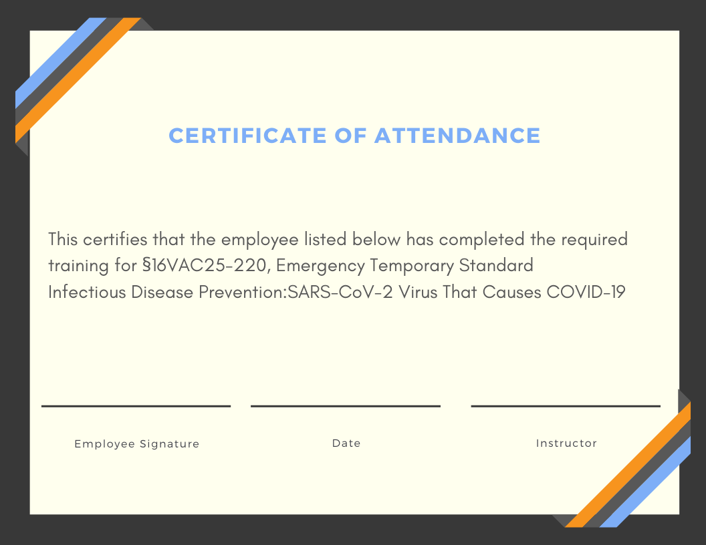

Slide 31

Program Conclusion
“Thank you for your attention and participation”
Jamie Hasty, Vice President

